Slide 1
Washington Fatal Crash Files
Team 026 - Jimmy Nguyen, John Dutan, Anthony Capasso

Slide 2



Table of Contents
Overview
Thought-Process
Solution
Washington Fatal Crashes Data Files – Data Analytics Level 4

Slide 3

Overview
Washington Fatal Crashes Data Files – Data Analytics Level 4

Slide 4



Overview
Washington State’s Official Highway Safety Office. Manages traffic safety programs in media and outreach.
Plan to reduce traffic deaths or injuries on roadways to zero by the year 2030.
Are the people who live in these communities the same people involved in fatal crashes that occur there?
Washington Fatal Crashes Data Files – Data Analytics Level 4

Slide 5
Overview
Washington Fatal Crashes Data Files – Data Analytics Level 4

Slide 6

Thought-Process
Washington Fatal Crashes Data Files – Data Analytics Level 4

Slide 7
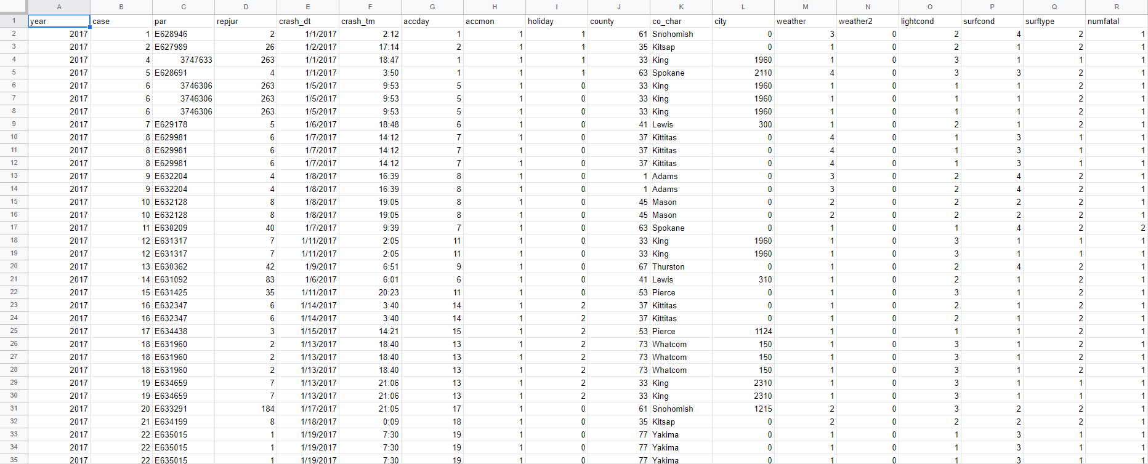
Thought-Process
Data Clean
Remove Empty Columns
Remove Unnecessary Columns
Colorize Data
Washington Fatal Crashes Data Files – Data Analytics Level 4

Slide 8
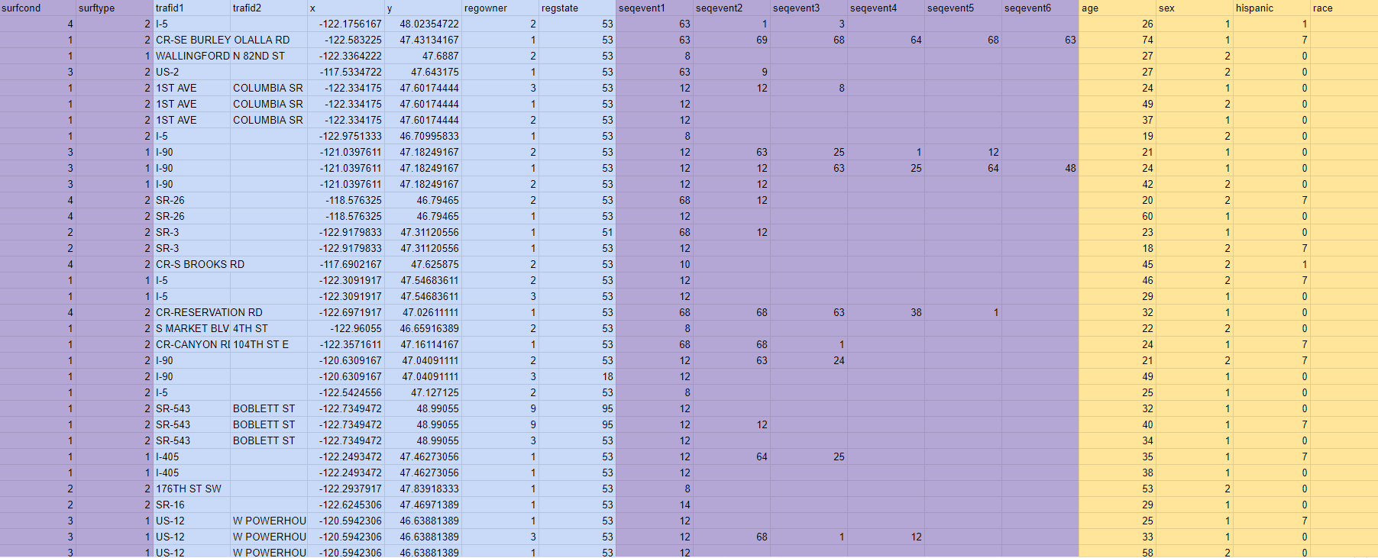
Thought-Process
Data Clean
Remove Empty Columns
Remove Unnecessary Columns
Colorize Data
Washington Fatal Crashes Data Files – Data Analytics Level 4

Slide 9
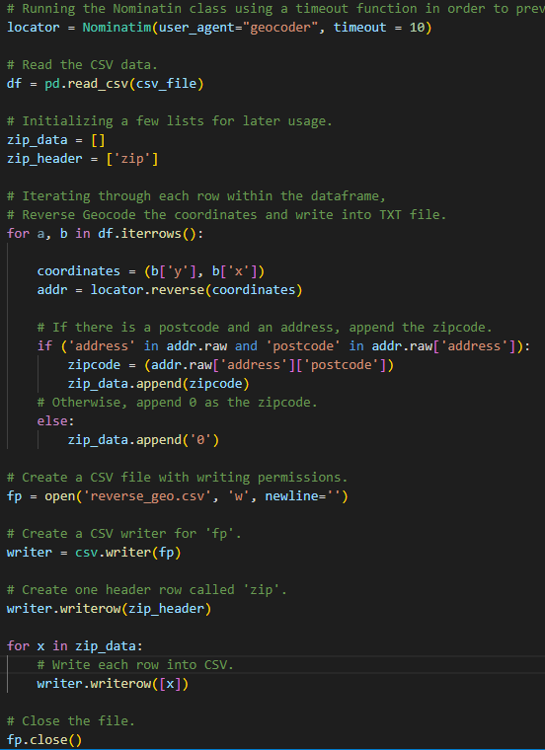
Thought-Process
Reverse Geocoding
Import Modules
Read CSV
Create a list
Convert list into CSV.
Reverse Geocode
Use X-Y coordinates to get zip code.
Append zip code onto list
Washington Fatal Crashes Data Files – Data Analytics Level 4

Slide 10
Thought-Process
Analyze Data
Use Spread Sheet Commands
Provide Visualization Through Tableau:
Zip Codes that produced the most dangerous drivers
Sequence of events were most common for crashes (within/outside community)
Compare zip codes to crash zip codes to categorize crashes within/outside community.
Using variety of tools to help us perform most of our analysis on dataset.
Data Analysis
Washington Fatal Crashes Data Files – Data Analytics Level 4

Slide 11
Thought-Process
Washington Fatal Crashes Data Files – Data Analytics Level 4

Slide 12


Solution
Washington Fatal Crashes Data Files – Data Analytics Level 4

Slide 13
Solution
1. Among drivers involved in fatal crashes, what proportion are involved in crashes in communities where they live?
a. Are there differences in the types of crashes and behavior factors in those crashes among “residents” versus those deemed to be not “from” the area?
Seq. of Events | Within County | Outside County
Motor Vehicle and Transport | 338 | 938
Run Off Road - Right | 153 | 444
Cross Centerline | 140 | 442
Collision with Pedestrian | 89 | 391
What We Learned:
About 1/3 of crashes happen ‘within the same zip code.’
Main sequence of events are the same for both ‘within county’ and ‘outside county’.
Crashes were more likely to occur at night or in dark conditions out of community.
Washington Fatal Crashes Data Files – Data Analytics Level 4

Slide 14
Solutions Cont.
2. Are there specific resident ZIP Codes that tend to produce higher-risk drivers that are involved in fatal crashes at a higher rate?
a. What are the population demographics of these high-risk driver producing ZIP Codes?
Tacoma
Pasco
Spanaway
Federal Way
Wapato
Washington Fatal Crashes Data Files – Data Analytics Level 4

Slide 15
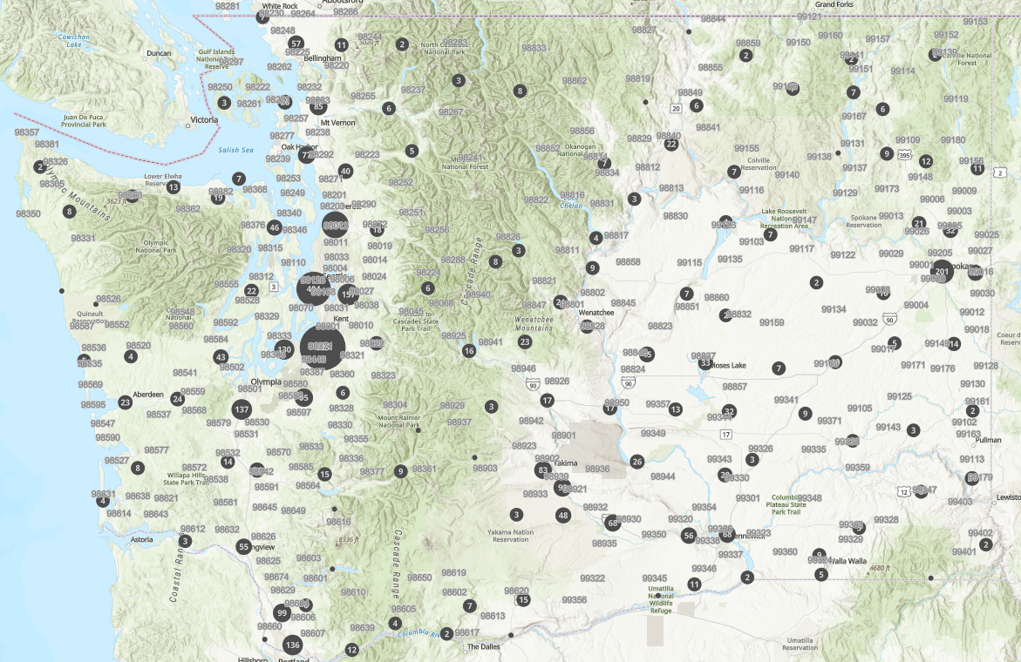
Washington Fatal Crashes Data Files – Data Analytics Level 4

Slide 16


Future Considerations
Create A Prediction Model
Analyze Pre-COVID vs Post-COVID
Washington Fatal Crashes Data Files – Data Analytics Level 4

Slide 17
Thank you!

